Slide 1
Math 8, I, II
Transformation Project
Information and Examples
Vincent

Slide 2
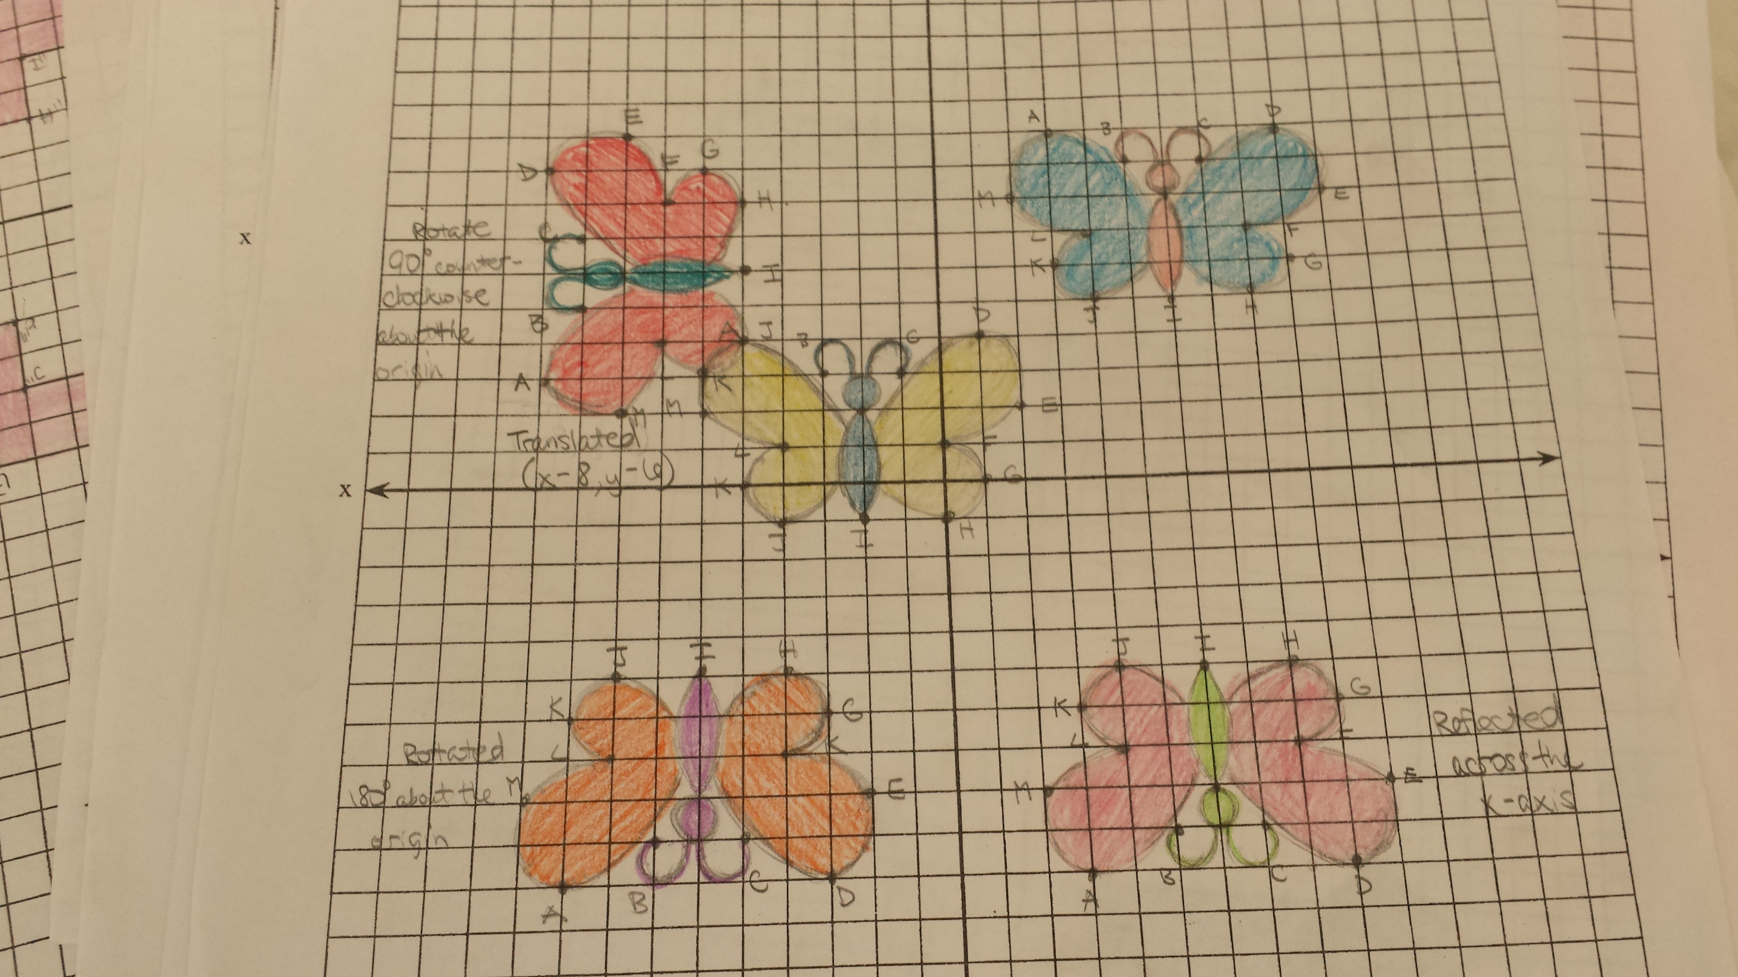
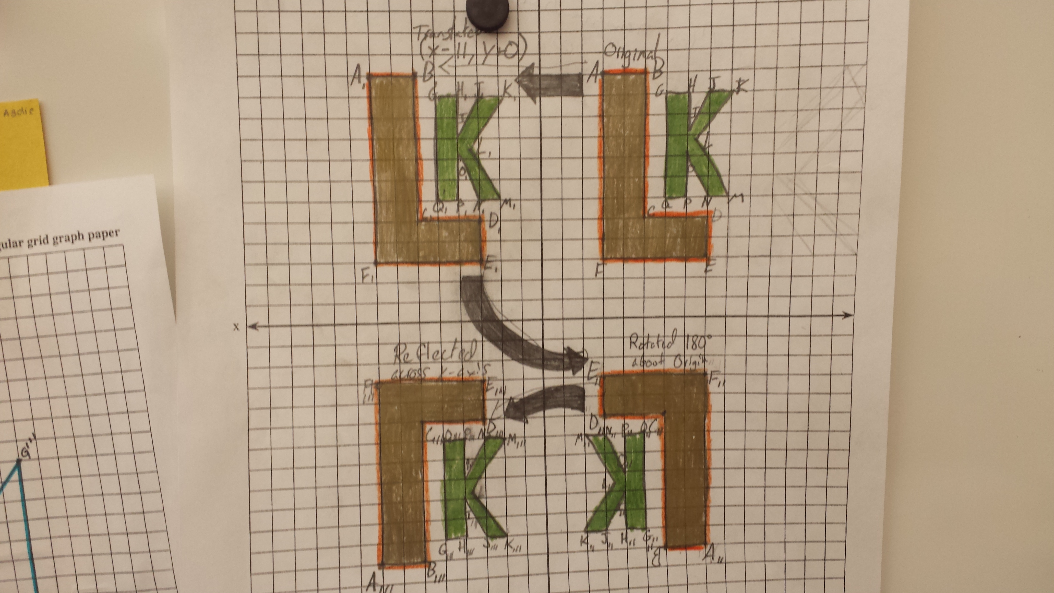
Standard 4: Model with mathematics.
Major Project:
Transformation Project

Slide 3
Major Project
Project on Translations, Reflections, and Rotations
I plan to incorporate art into math this year. This project requires students to draw a pre-image, and then accurately translate it, reflect it, and rotate it into images. They can do these transformations in any order; they just need to document all the transformation rules and label the vertices correctly.
Complete all projects using pencil! Add color when project is complete. Make sure all transformations are accurate before you begin to color. Add color to project with colored pencils please!
BLOG AT WORDPRESS.COM. (2016). Retrieved July 18, 2016 from https://pperfectsquares.wordpress.com/tag/graphing/

Slide 4
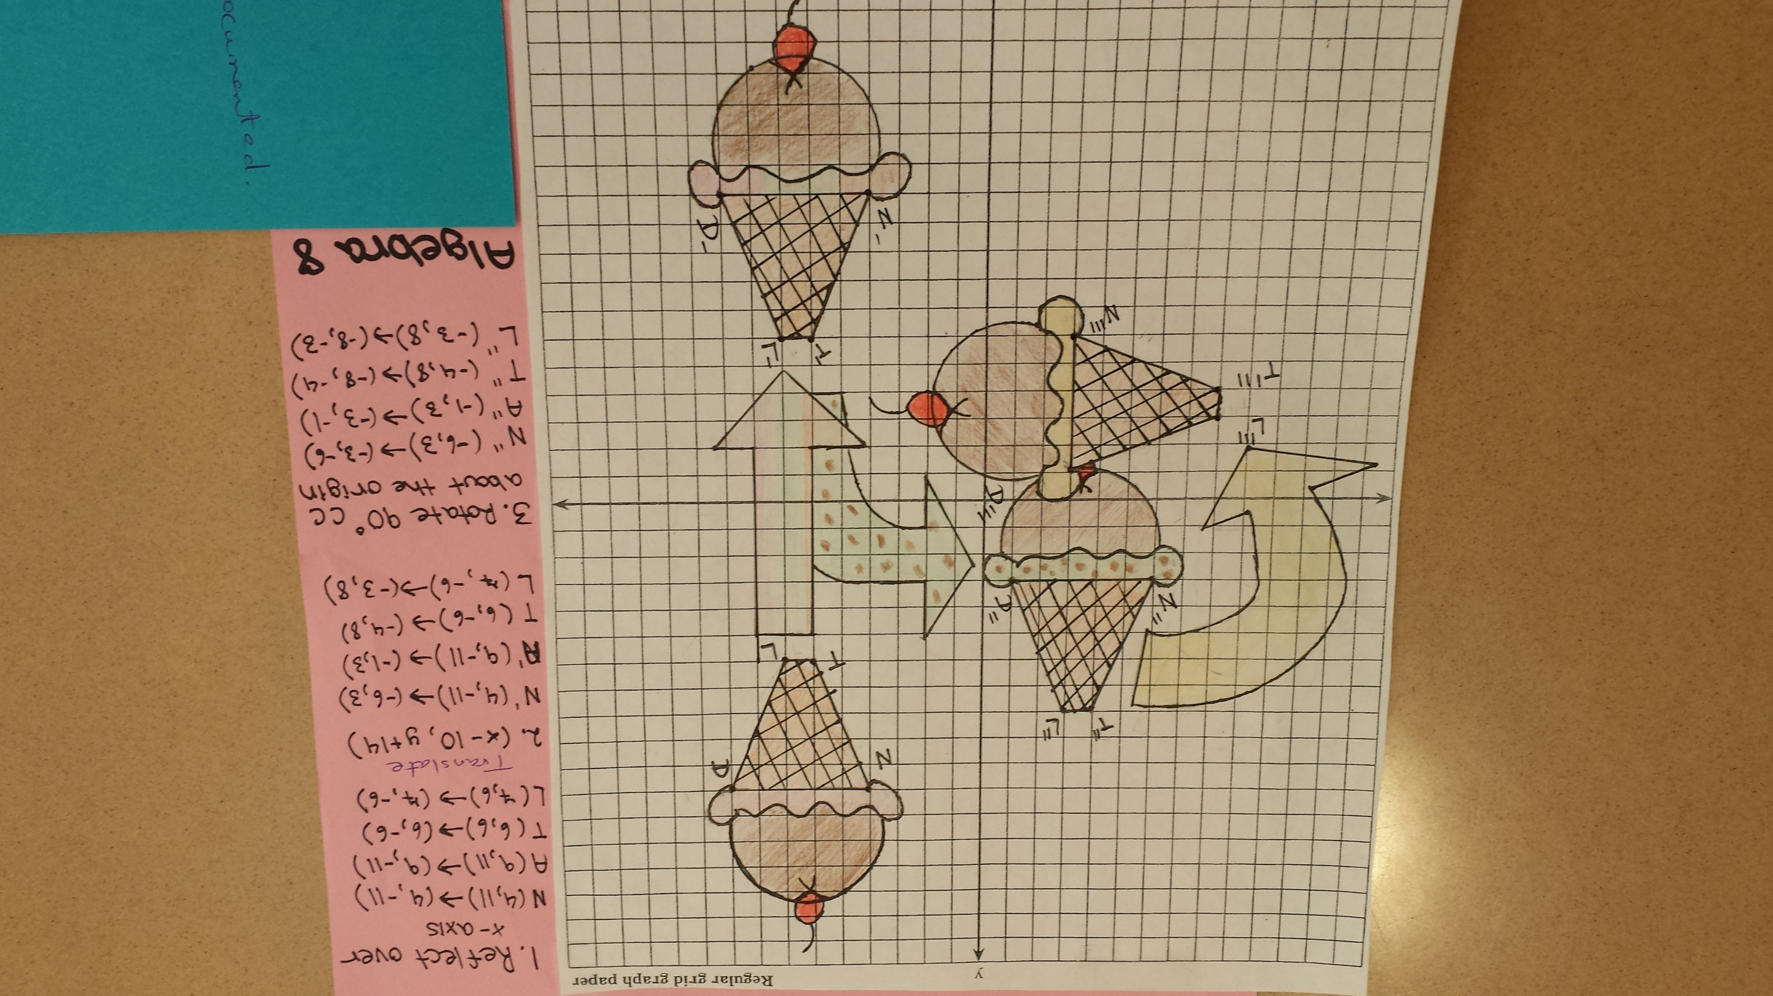
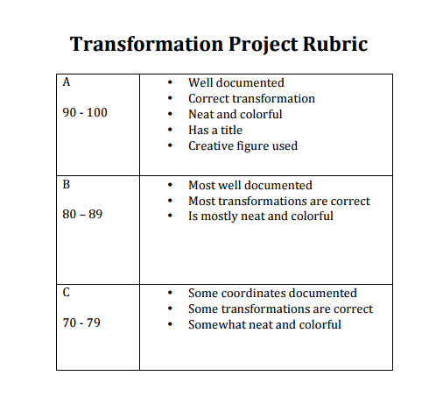
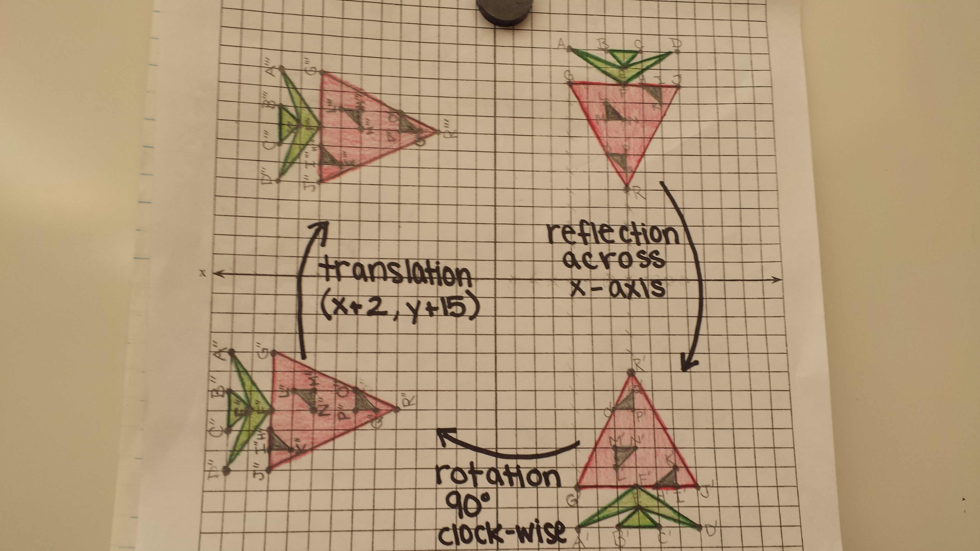

Slide 5
Brain-Friendly
Instruction
Please refer to the following websites for more details concerning the project.
https://pperfectsquares.wordpress.com/tag/graphing/
https://www.desmos.com/
Sources:

Slide 6
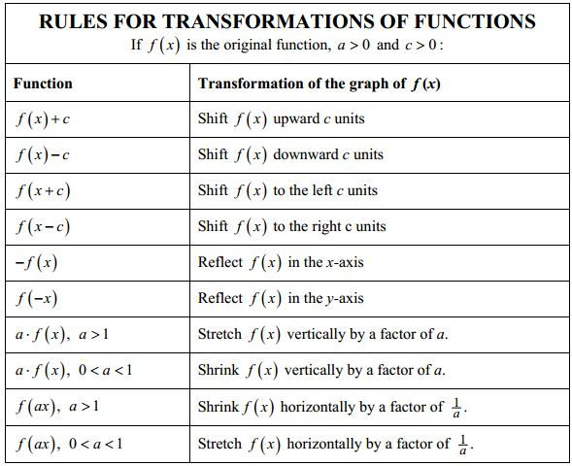
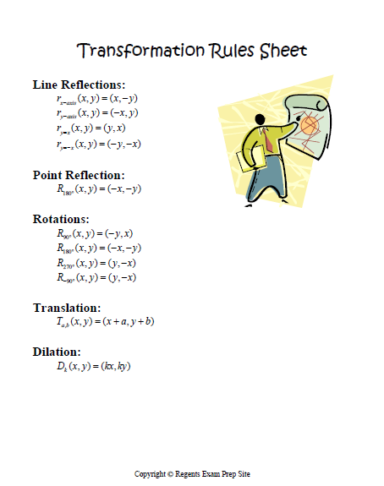
Transformation Project
Google Images. (2016). Retrieved July 2016, https://images.google.com Retrieved from Google Images. July, 18, 2016.
https://www.google.com/webhp?sourceid=chrome-instant&ion=1&espv=2&ie=UTF-8#q=images%20for%20transformation%20rules%20google

